Slide 1
Indian Institute Of Information Technology Pune
Department of Computer Science and Engineering
Fake News Detection Using Data Science
- Presented by Vaibhav Sodhi

Slide 2

Overview:
What is Data Science?
Steps of Data Science Modeling
Introduction To Problem Statement
Plan of Action
Dataset Required
Features (Step 1)
Classifiers (Step 2)
Results
Conclusion
Future Work
References

Slide 3



Data science is typically a “concept to bring together statistics, data analysis, and their related methods” to understand and analyze the actual phenomena with data.
It is the field of applying advanced analytics methods and scientific concepts to derive useful business information from data.
What is Data Science?

Slide 4

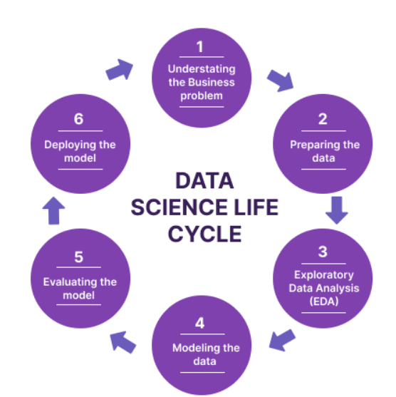
Steps Of Data Science Modeling
Understanding Business Problem
Means getting a clear understanding of the
problem that is needed to be solved , how
it impacts any relevant organization or
individual.
Once the problem is clearly stated then we can
think of solving it further.

Slide 5
2) Understanding Data
The real world Data is often inconsistent have missing values which needs to be filtered
The data understanding module includes figuring out what data would be best needed and the best ways to acquire it.
This phase includes an approach to analyse Data Sets often with visual methods.
this phase offers tools for creating hypotheses by generally visualizing and interpreting the data through graphical representation such as a chart, plot, histogram, etc
3) Data Preprocessing

Slide 6


4) Machine Learning Modeling
Once the data is prepared for building the model, data scientists design a model, algorithm, or set of models, to address the business problem.
We usually separate dataset in the ratio of 80:20 ,
80 % for training the dataset with given input and known output and rest 20% to test the model & compare its output with actual output.
5) Data product and automation
- A data product is basically the output of any data science activity .

Slide 7
Introduction to Problem Statement
In the current society anyone who is having the access of internet can spread untrue , biased information . It has become impossible to prevent Fake news from being created so the next step is to differentiate Fake news from Real news.
One possible solution may be fact checking but it is useless and time consuming
so the next step is to identify fake news using the concepts of Data Science.
Data science being a field to find patterns in data can help us to differentiate between Fake news and real news.

Slide 8

Plan Of Action
The plan is to initially collect a large amount of data already known and verified as Fake News and then try to train a model that will find the probability of it being Fake News.
Detection of Fake News will be done in two major Steps:
i) Feature Extraction : The text needs to be turned into something more useful known as feature extraction , it can be of many forms like word count , sentiment analysis , part of speech analysis , Entity Recognition . Features are basically a numeric value which describe the text
ii) Classifier : Give features as input to classifiers to get to know that the text having these features belong to fake news category or not .

Slide 9

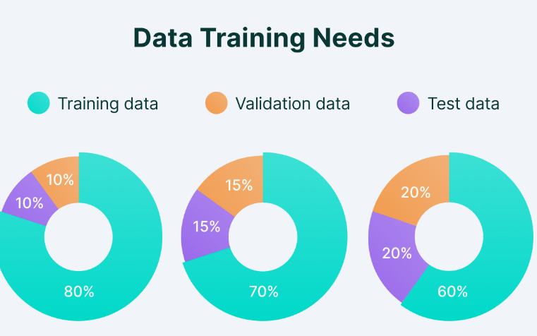
Dataset required
We will require one Dataset to first train the machine , the largest available Dataset having over 40,000 articles is ISOT (Information Security and object Technology) Fake News Dataset having over 21000 articles labeled as real and over 23000 articles labeled as Fake .
Next we will be using a Dataset to test the model , for testing we will use 20% of ISOT dataset and whole of the new Dataset which is being Selected . This new Dataset can be Fake News Net , it has full length articles, however there are only 422 labeled articles in it

Slide 10

Features (Step 1)
Features are numerical values which will describe the text , the main aim is to find a feature that will give most accurate results. Some of the features being used are :
Word Count : Means the number of times a particular word is being occurred
N-gram Count: These are series of n items , such as words , for example n-gram of word ‘features’ may be ‘fe’ , ‘ea’ , ‘tu’ , ‘tur’ .
Term frequency-inverse document frequency (TF-IDF) : TF-IDF is a way to rank the importance of a term within a text with respect to all the texts in the collection. It ranks common words as less important (smaller numeric value) and less used words as more important (large numeric values).

Slide 11
4) VADER(Valence Aware Dictionary and Sentiment Reasoner) : Fake news often tries to manipulate with readers emotions . So sentiment analysis can help to detect fake news .
Vader gives four numbers , how negative the tone of the text is , how positive it is , how neutral it is , how compound it is .
5) Stop Words: These are the most common words which needs to be removed to make the text distinct. Two English ready-made lists are NLTK’s (Natural Language Toolkit) stopword list and spaCy’s stop word list.
6) Lemmatization (Lemma): Means focusing to the root of the word i.e words like foot and feet will be treated in same category by the classifiers.
7) Named Entity Recognition : The process of identifying persons, organizations, and other named entities. By labeling words as ‘person’ or ‘organizations’ algorithms can pick on patterns involving these entities

Slide 12
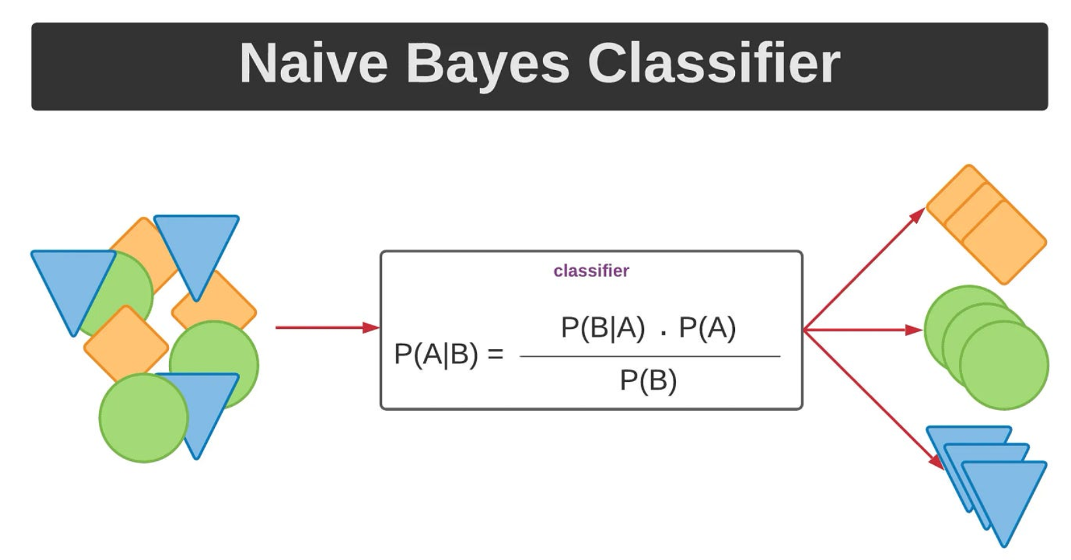
Classifiers (Step 2)
Two classifiers are being used here once the feature extraction is done and their results are being compared further :
i) Naive Bayes: It is a probabilistic classification
algorithm based on Bayes' theorem .
It calculates the probability that a data point belongs
to each class based on the features observed,
and then assigns the class with the highest
probability.
It does this for every feature and in the end combine
all individual probabilities to reach to a final classification .

Slide 13

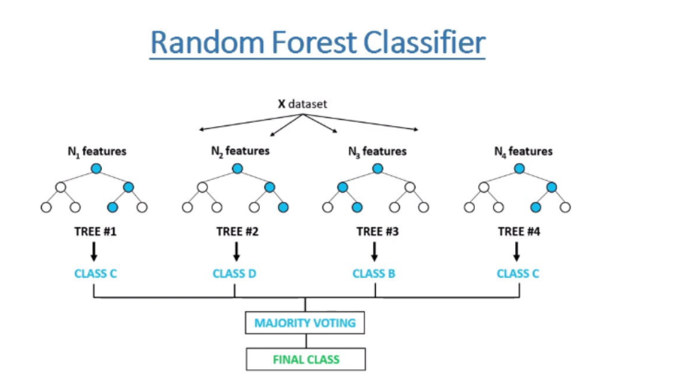
It is a type of classifier made using decision trees. But, instead of a decision tree training on all of the data, each decision tree will get a random subset of the data
train on.
Each decision tree of the forest will give its own classification and in the end which
ever classification gets the most number of votes wins.
ii) Random Forest :

Slide 14

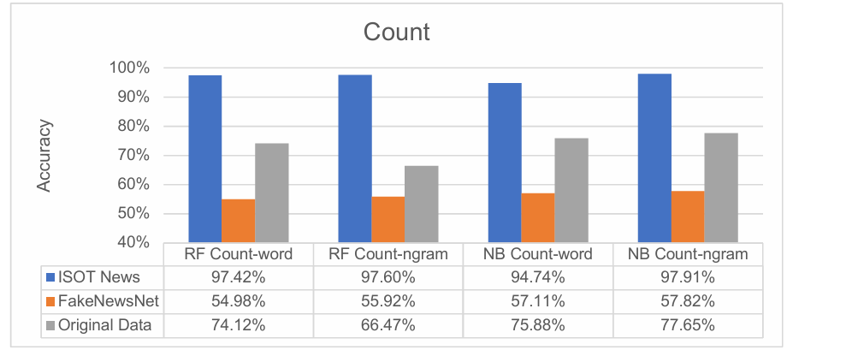
Results
Using the two different models as described above various features were tested and the results of both classifiers were compared (Original dataset is a small dataset which was prepared for this research only)
We can observe from this result that the ISOT testing Dataset is getting better results than the Fake News Net dataset and the original dataset.
The NB classifier gets better accuracy with count n-gram.

Slide 15
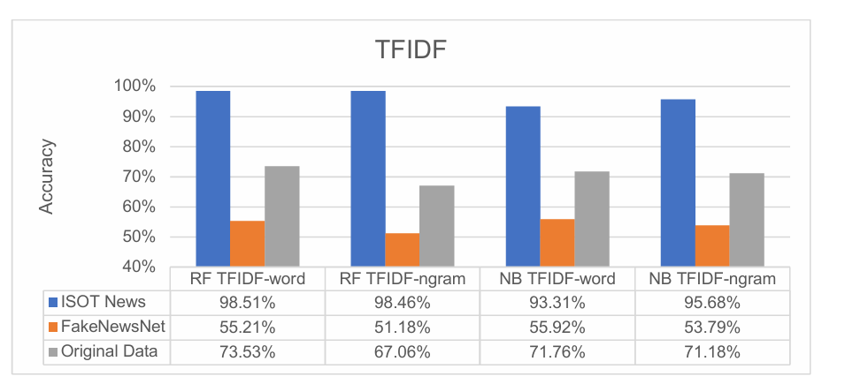
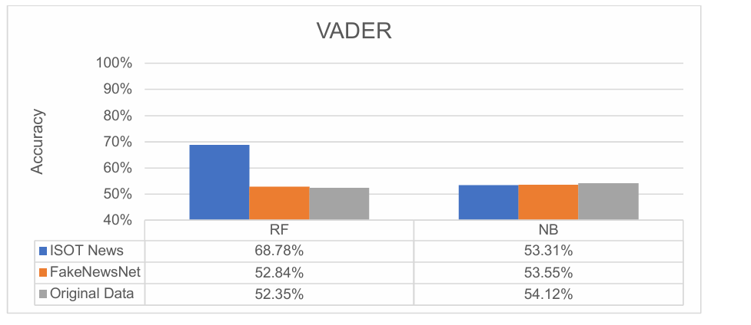
With TFIDF also the ISOT dataset has the highest accuracies , random forest is getting more accurate output in case of ISOT dataset.
Between TFIDF and Count, the Count-ngram is getting the best accuracy results
With Vader feature we can see that very less accurate results are coming.
This shows that vader alone is not good to classify some text as fake news.

Slide 16

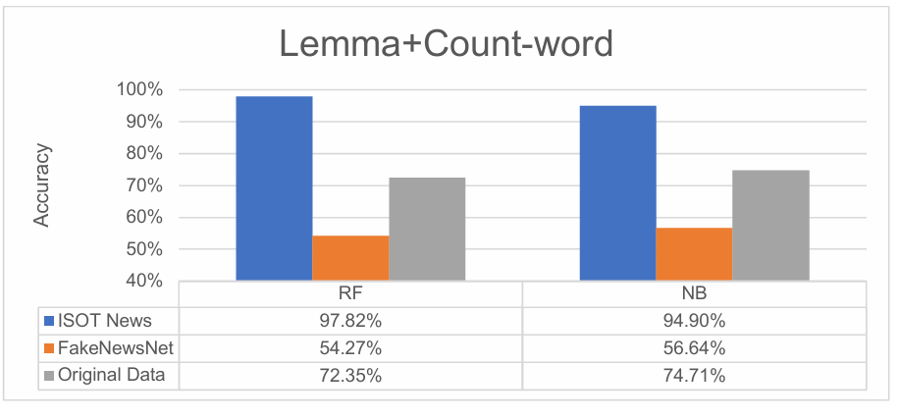
Here also ISOT is dominating in accuracy
The NB classifier is still generalizing better than the RF classifier. The results from lemma are better than some of the other features.
From the above results some general conclusions can be made which are described in further slides

Slide 17

Conclusions
i) As the ISOT dataset was achieving much more accuracy compared to other datasets , it means that the classifiers are detecting some pattern in ISOT which is not being done with other datasets. Which is the major drawback here.
ii) Other observation was that more accurate results
were coming with the original dataset which was used
in this research compared to FakeNewsNet Dataset.
iii) With respect to features it can be concluded that
better results were coming with count and TFIDF com-
pared to VADER , ER , Lemma , POS etc.

Slide 18
Future Work
i) Some different dataset should be used to train classifiers instead of ISOT . But due to the size of ISOT , it is a valuable dataset which can be now used for testing purposes.
ii) Combinations of features should be tested i.e we should combine one or more features
(eg: ER with lemma) and then pass them to get classified. As we can see from the output that combined features can produce results with better accuracy.
iii) We should also try to build a model which can classify between real news , fake news , and a satire , it would be beneficial as satire is type of deceptive news which isn't actually fake. By doing this we will get a better understanding how to accurately identify fake texts.

Slide 19
References
Data Science and Analytics: An Overview from Data‑Driven Smart Computing, Decision‑Making and Applications Perspective . SN Computer Science (2021) 2:377 https://doi.org/10.1007/s42979-021-00765-8
Shoemaker, Eliza, "Using data science to detect fake news" (2019). Senior Honors Projects, 2010-current. 714. https://commons.lib.jmu.edu/honors201019/714

Slide 20

THANK YOU !!
Name : Vaibhav Sodhi
MIS: 112215192
Academic Year : 2nd

